Slide 1
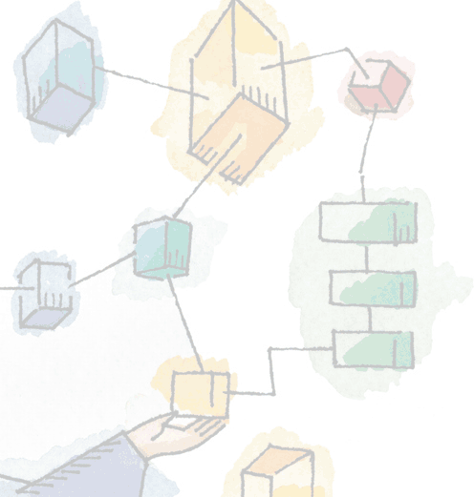
Operating Systems: Internals and Design Principles, 6/E
William Stallings
Chapter 4 Threads, SMP, and Microkernels

Slide 2
Thread adalah unit pemrosesan yang lebih kecil dari proses.
Setiap thread dalam satu proses berbagi ruang alamat yang sama dan sumber daya sistem lainnya.
Thread dapat dianggap sebagai "cabang" atau "sub-program" dari proses utama dan dapat dijalankan secara bersamaan dengan thread lain dalam proses yang sama.
Perbedaan utama antara thread dan proses adalah bahwa proses merupakan entitas yang independen yang dapat berjalan secara terpisah dan mandiri dari proses lain, sedang thread adalah bagian dari proses yang membagi sumber daya sistem dengan thread lain di dalam proses yang sama.

Slide 3
Processes and Threads
Processes have two characteristics:
Resource ownership - process includes a virtual address space to hold the process image
Scheduling/execution - follows an execution path that may be interleaved with other processes
Kedua karakteristik ini diperlakukan secara mandiri oleh operating system

Slide 4
Processes and Threads
Proses adalah program yang sedang berjalan di dalam sistem operasi. Setiap proses memiliki ruang alamat yang unik dan membutuhkan sumber daya seperti CPU, memori, dan perangkat masukan/keluaran.
Proses dapat menjalankan satu atau lebih thread.

Slide 5
Processes and Threads
The unit of dispatching : disebut sebagai sebuah thread atau proses ringan.
The unit of resource ownership (Unit kepemilikan sumber daya ) is referred to as a process or task

Slide 6

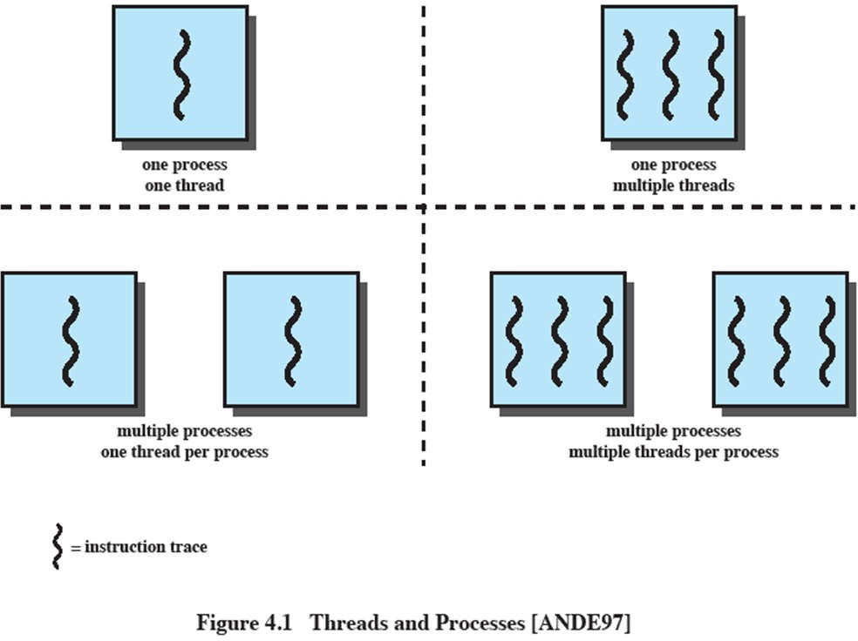


Multithreading
Kemampuan sistem operasi untuk mendukung multiple, concurrent paths (jalur eksekusi bersamaan) dalam satu proses.

Slide 7
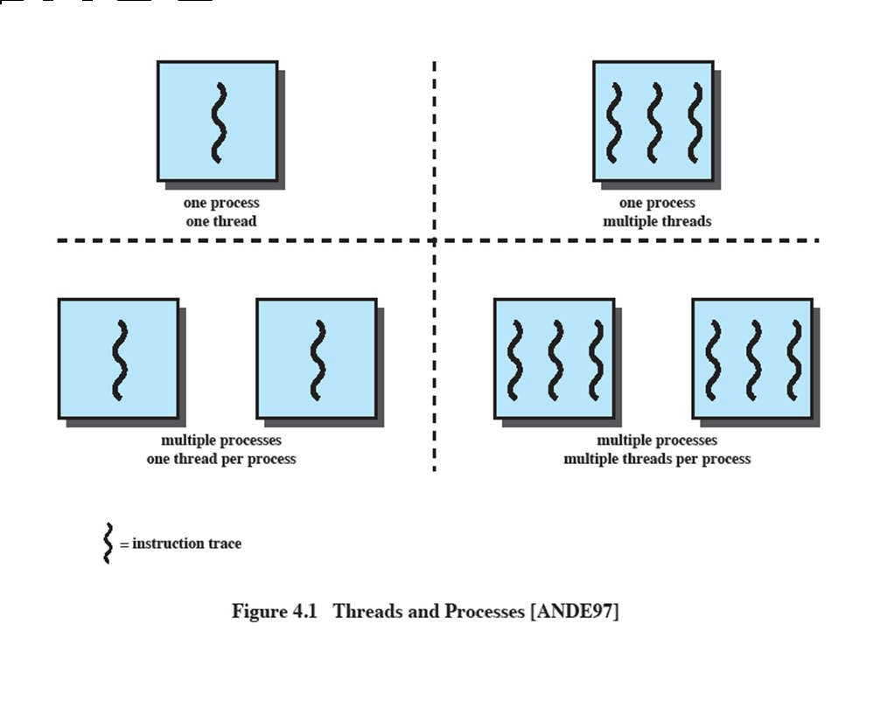
Single Thread Approaches
MS-DOS supports a single user process and a single thread.
Some UNIX, support multiple user processes but only support one thread per process

Slide 8

Multithreading
Java run-time environment is a single process with multiple threads
Multiple processes and threads are found in Windows, Solaris, and many modern versions of UNIX

Slide 9
Processes
A virtual address space which holds the process image
Protected access to
Processors,
Other processes,
Files,
I/O resources

Slide 10
One or More Threads in Process
Each thread has
An execution state (running, ready, etc.)
Saved thread context when not running (Konteks thread yang tersimpan ketika tidak sedang berjalan.)
An execution stack
Some per-thread static storage for local variables (Penyimpanan statis per-thread untuk variabel lokal.)
Access to the memory and resources of its process (semua thread dari sebuah proses berbagi ini).

Slide 11
One view…
Salah satu cara untuk melihat sebuah thread adalah sebagai program counter independen yang beroperasi dalam sebuah proses.

Slide 12
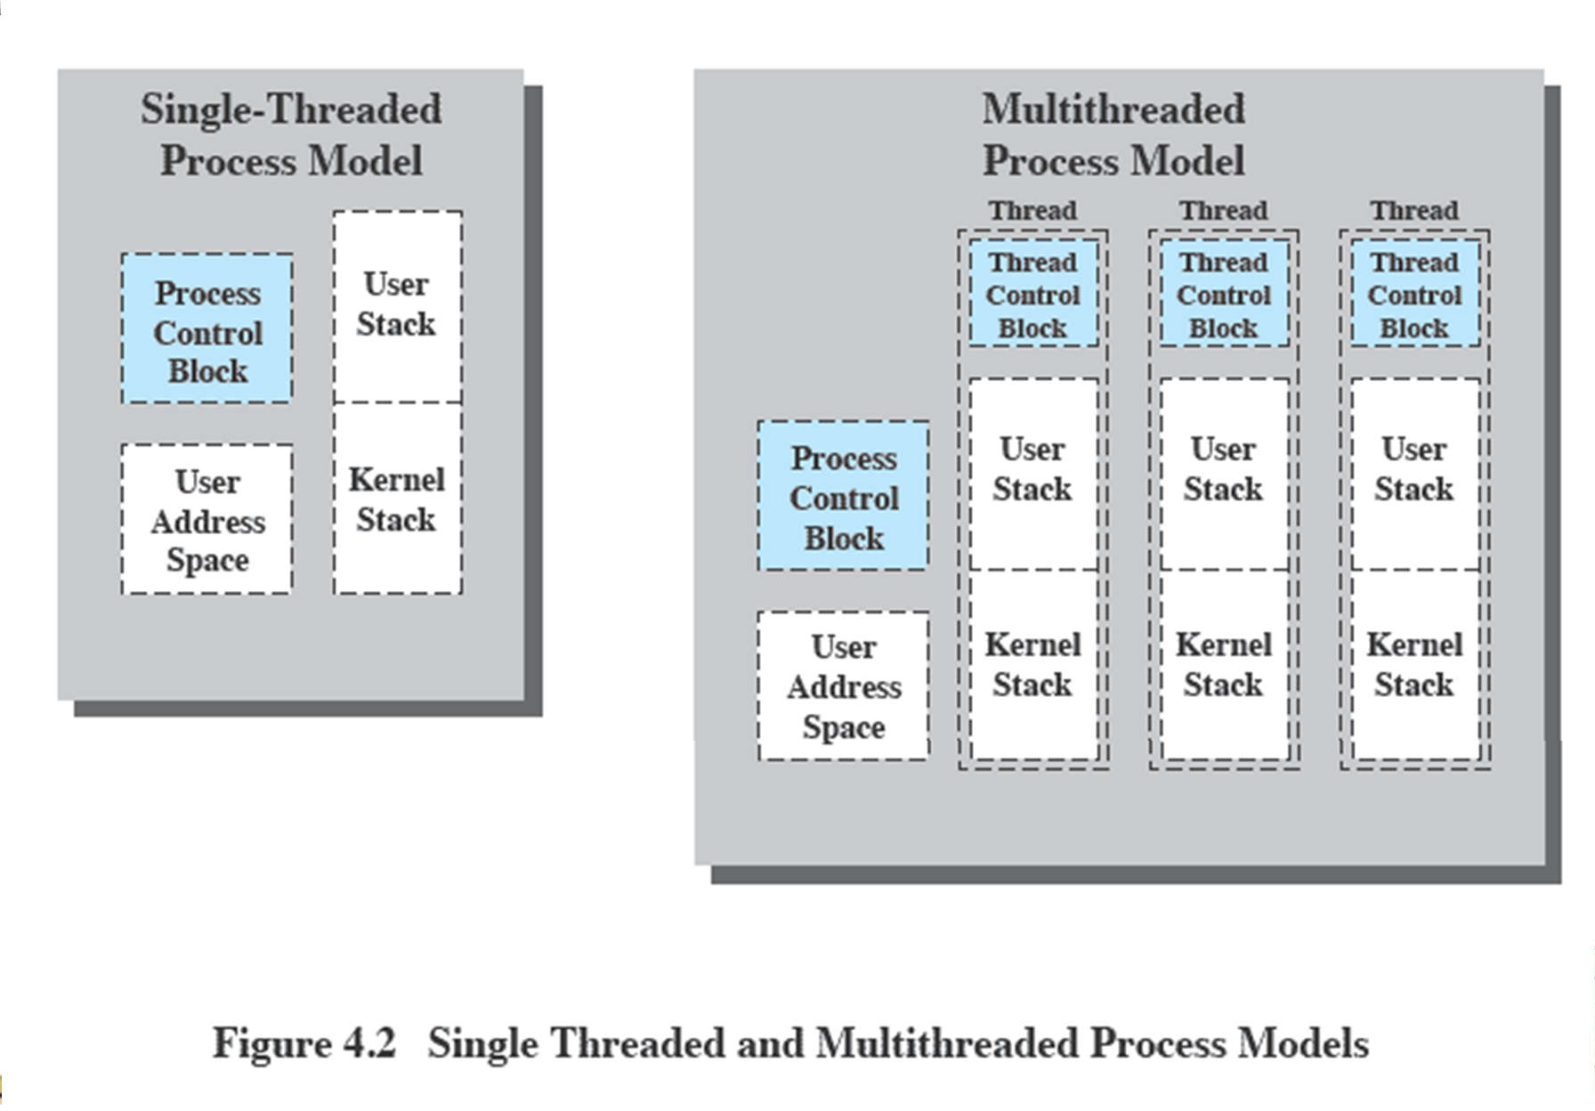
Threads vs. processes

Slide 13
Benefits of Threads
Waktu untuk membuat thread lebih sedikit dari pada membuat proses
Less time to terminate a thread than a process
Switching between two threads takes less time that switching processes
Thread dapat berkomunikasi satu sama lain tanpa memanggil kernel.

Slide 14
Thread use in a Single-User System
Foreground and background work
Asynchronous processing
Speed of execution
Modular program structure

Slide 15
Threads
Beberapa tindakan yang mempengaruhi semua thread dalam sebuah proses
→ Sistem operasi harus mengelola ini pada level proses.
Contoh:
Menangguhkan sebuah proses mengakibatkan menangguhkan semua thread dari proses tersebut.
Termination of a process, terminates all threads within the process

Slide 16
Activities similar to Processes
Threads have execution states and may synchronize with one another.
Similar to processes
We look at these two aspects of thread functionality in turn.
States
Synchronisation

Slide 17
Thread Execution States
State yang terkait dengan perubahan dalam status thread:
Spawn (membuat thread baru)
Block
Issue: apakah mem block satu thread akan me block yang lain, atau semua, thread?
Unblock
Finish (thread)
Deallocate (membebaskan) register context and stacks

Slide 18
Example: Remote Procedure Call
Tugas:
Sebuah program yang melakukan dua panggilan prosedur jarak jauh (RPC) ke dua host yang berbeda untuk mendapatkan hasil yang digabungkan.

Slide 19
Langkah-langkah
Inisialisasi: Program menginisialisasi dan mempersiapkan untuk melakukan panggilan prosedur jarak jauh (RPC).
Panggilan RPC 1: Program mengirimkan permintaan panggilan prosedur jarak jauh (RPC) pertama ke host pertama.
Menunggu Respons RPC 1: Program menunggu respons dari host pertama untuk panggilan RPC 1.
Panggilan RPC 2: Setelah menerima respons dari host pertama untuk RPC 1, program mengirimkan permintaan panggilan prosedur jarak jauh (RPC) kedua ke host kedua.
Menunggu Respons RPC 2: Program menunggu respons dari host kedua untuk panggilan RPC 2.

Slide 20
RPC
Using Single Thread

Slide 21
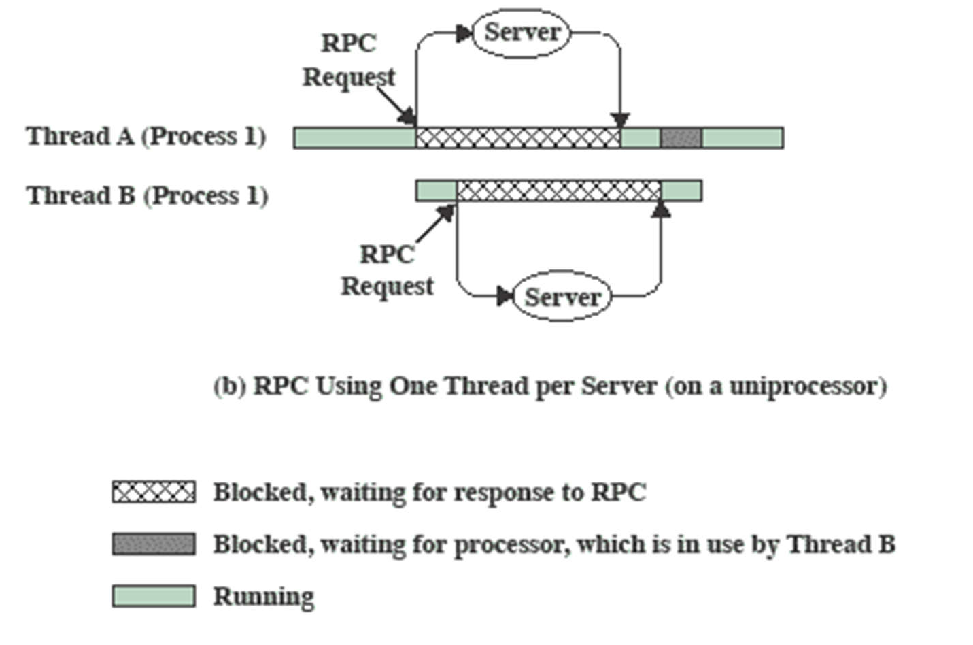
RPC Using
One Thread per Server

Slide 22
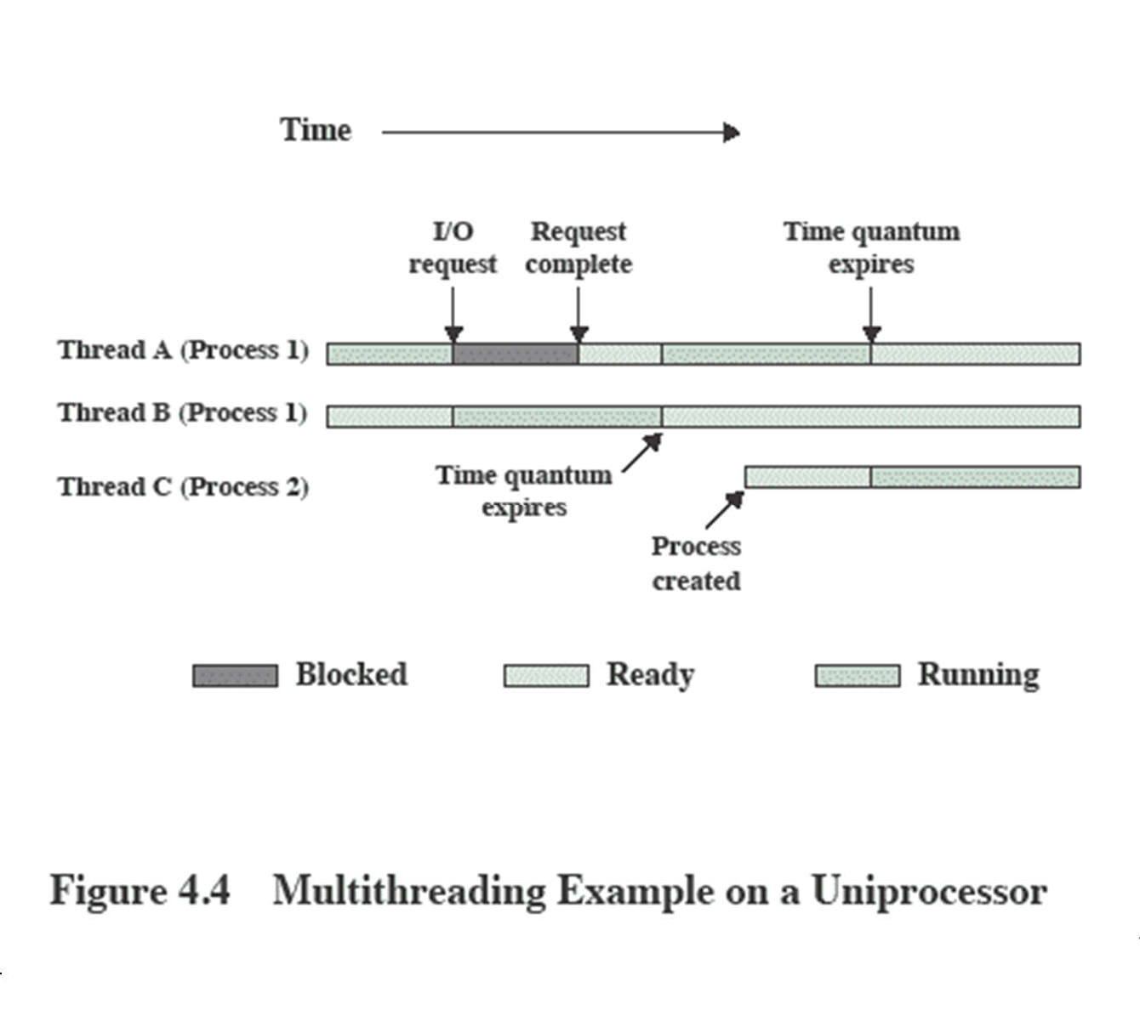
Multithreading on a Uniprocessor

Slide 23
Categories of Thread Implementation
User Level Thread (ULT)
Kernel level Thread (KLT) also called:
kernel-supported threads
lightweight processes.

Slide 24
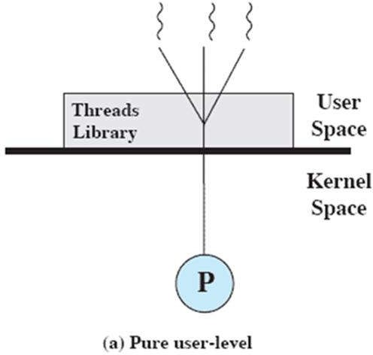
User-Level Threads
All thread management is done by the application
The kernel is not aware of the existence of threads

Slide 25
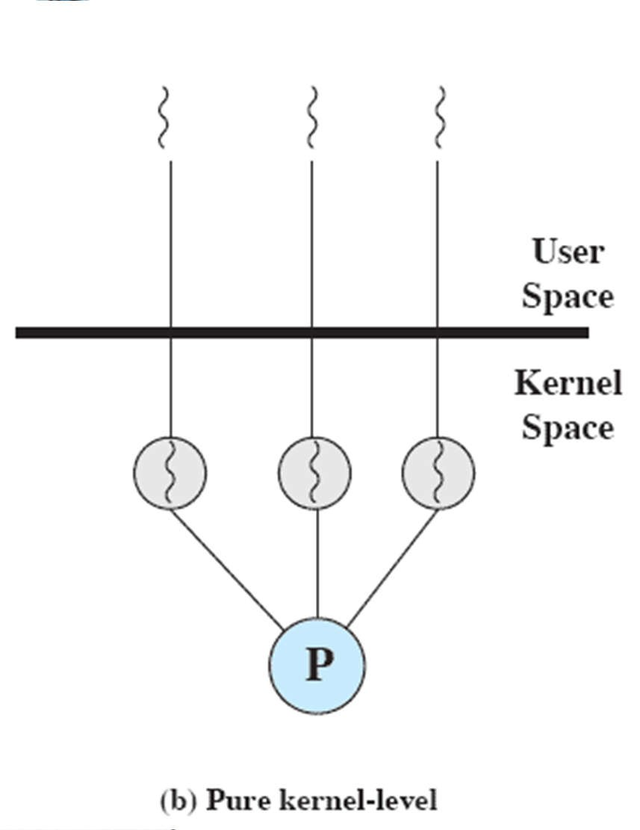
Kernel-Level Threads
Kernel maintains context information for the process and the threads
– No thread management done by application
Scheduling is done on a thread basis
Windows is an example of this approach

Slide 26
Advantages of KLT
The kernel can simultaneously schedule multiple threads from the same process on multiple processors.
If one thread in a process is blocked, the kernel can schedule another thread of the same process.
Kernel routines themselves can be multithreaded.

Slide 27
Disadvantage of KLT
The transfer of control from one thread to another within the same process requires a mode switch to the kernel

Slide 28
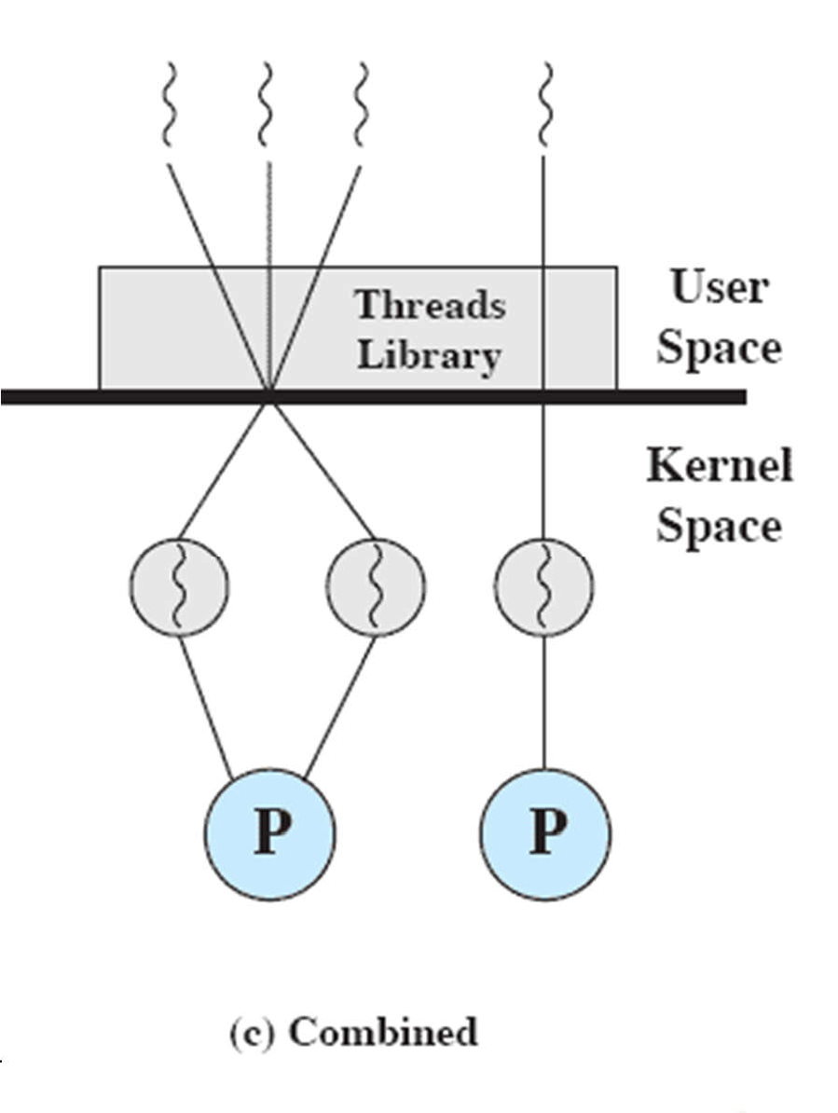
Combined Approaches
Thread creation done in the user space
Bulk of scheduling and synchronization of threads by the application
Example is Solaris

Slide 29
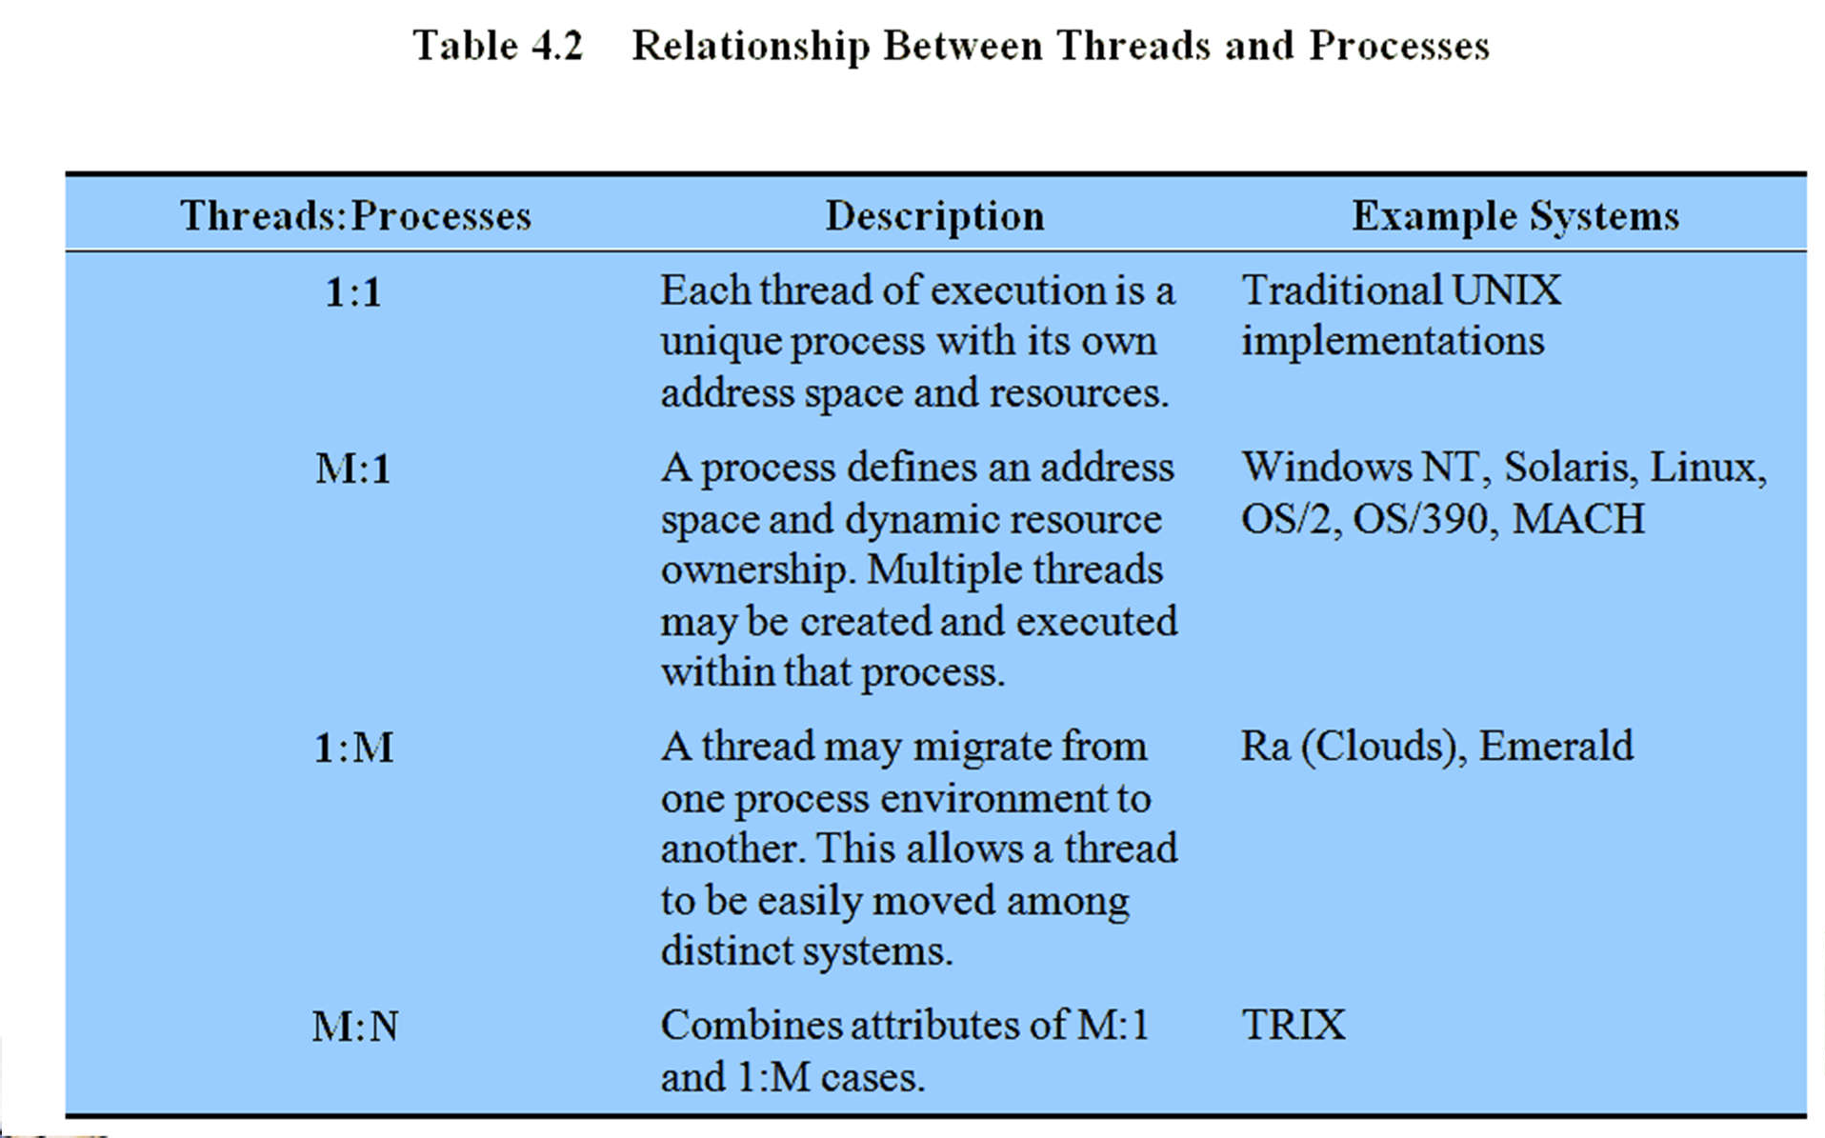
Relationship Between Thread and Processes

Slide 30
Roadmap
Threads: Resource ownership and execution
Symmetric multiprocessing (SMP).
Microkernel
Case Studies of threads and SMP:
Windows
Solaris
Linux

Slide 31
Traditional View
Traditionally, the computer has been viewed as a sequential machine.
A processor executes instructions one at a time in sequence
Each instruction is a sequence of operations
Two popular approaches to providing parallelism
Symmetric MultiProcessors (SMPs)
Clusters (ch 16)

Slide 32
Categories of Computer Systems
Single Instruction Single Data (SISD) stream
Single processor executes a single instruction stream to operate on data stored in a single memory
Single Instruction Multiple Data (SIMD) stream
Each instruction is executed on a different set of data by the different processors

Slide 33
Categories of Computer Systems
Multiple Instruction Single Data (MISD) stream (Never implemented)
A sequence of data is transmitted to a set of processors, each of execute a different instruction sequence
Multiple Instruction Multiple Data (MIMD)
A set of processors simultaneously execute different instruction sequences on different data sets

Slide 34
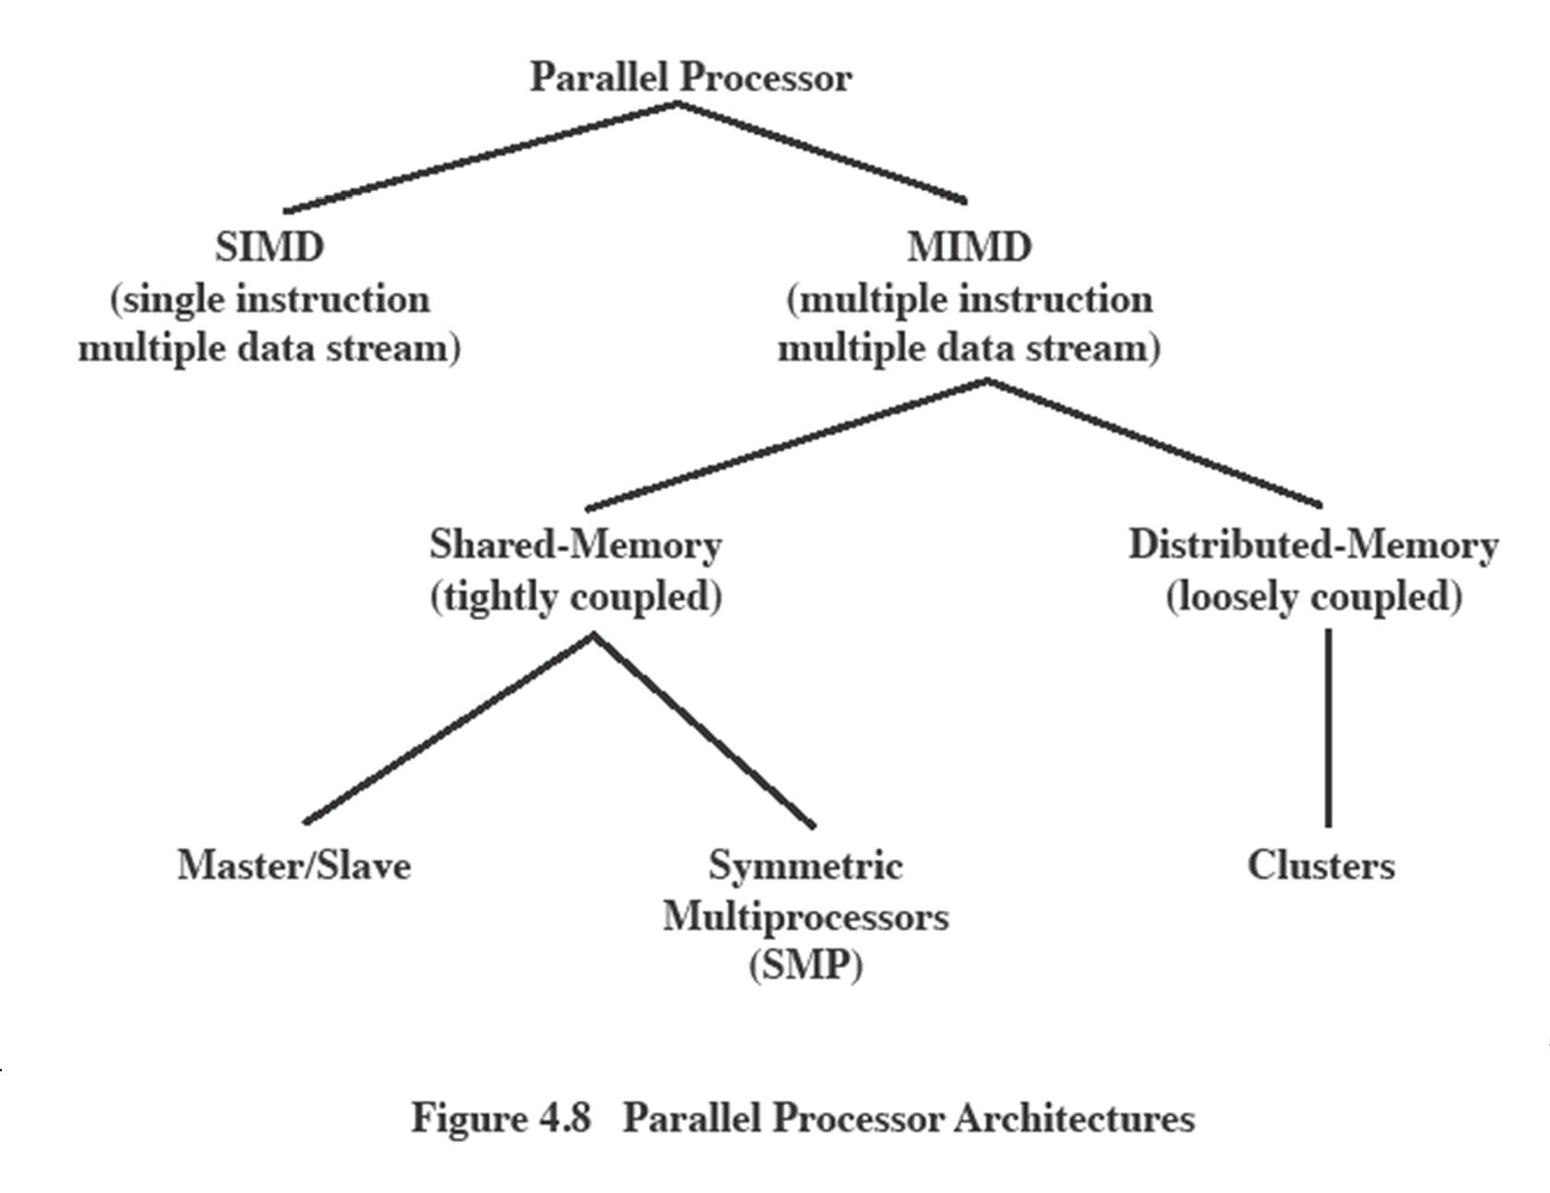
Parallel Processor Architectures

Slide 35
Symmetric Multiprocessing
Kernel can execute on any processor
– Allowing portions of the kernel to execute in parallel
Biasanya prosesor melakukan penjadwalan sendiri dari kumpulan proses atau thread yang tersedia

Slide 36
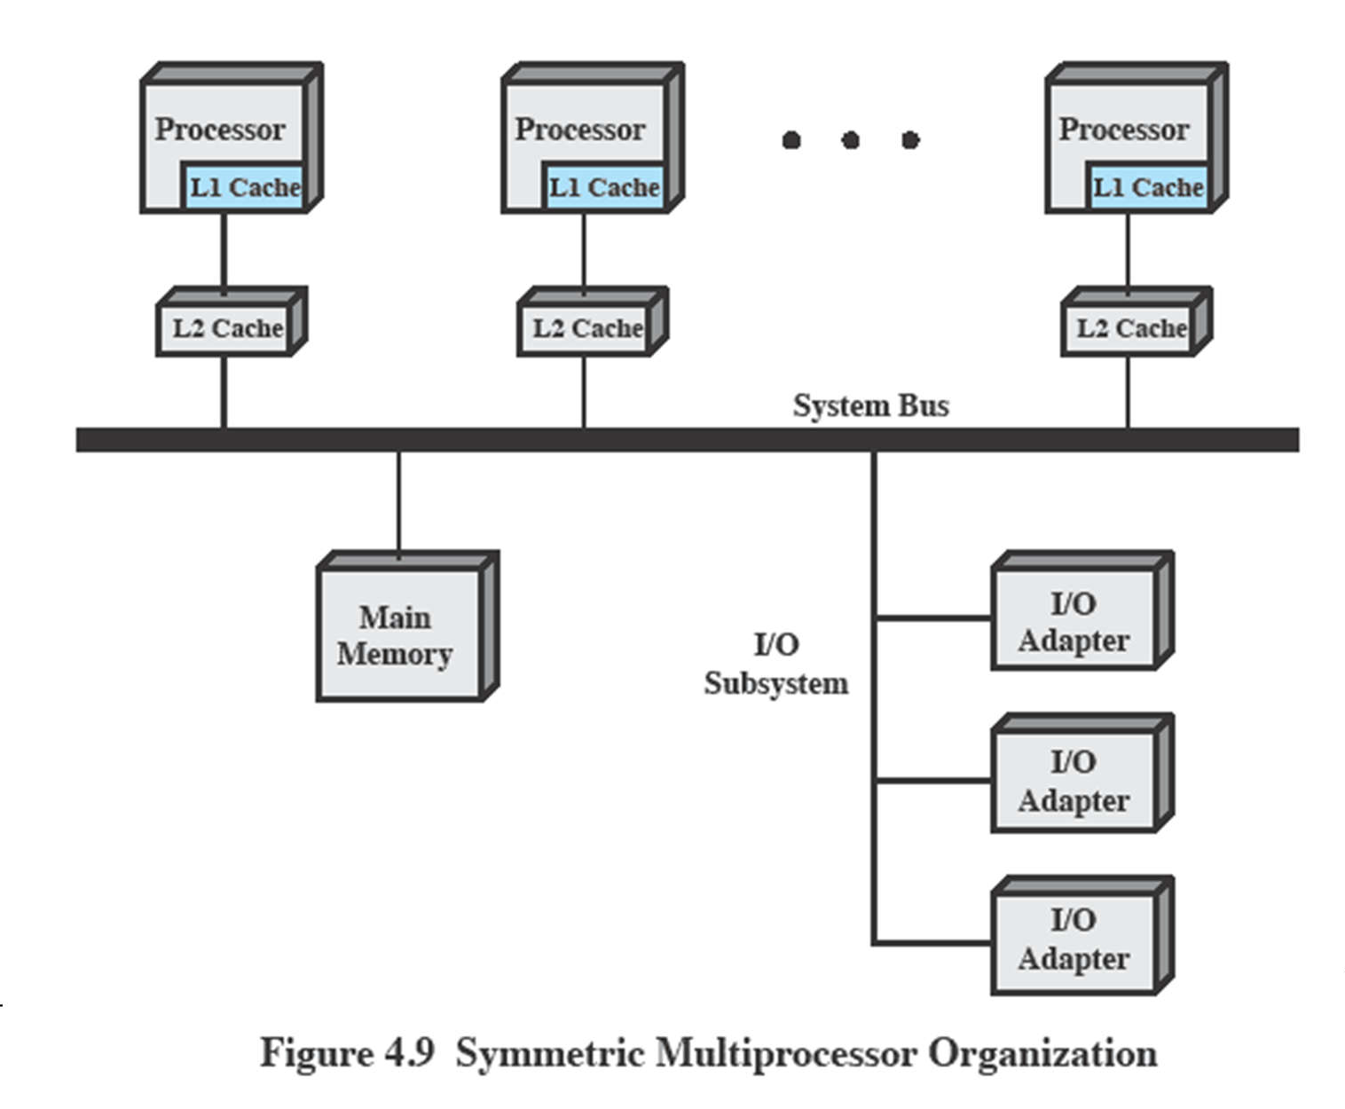
Typical
SMP Organization

Slide 37
Multiprocessor OS Design Considerations
The key design issues include
Simultaneous concurrent processes or threads
Scheduling
Synchronization
Memory Management
Reliability and Fault Tolerance

Slide 38
Microkernel
Mikrokernel adalah inti OS kecil yang menyediakan fondasi untuk ekstensi modular.
Pertanyaan besarnya adalah seberapa kecil kernel harus memenuhi syarat sebagai mikrokernel
Must drivers be in user space?(Driver harus di ruang pengguna?)
Secara teori, pendekatan ini memberikan tingkat fleksibilitas dan modularitas yang tinggi.

Slide 39
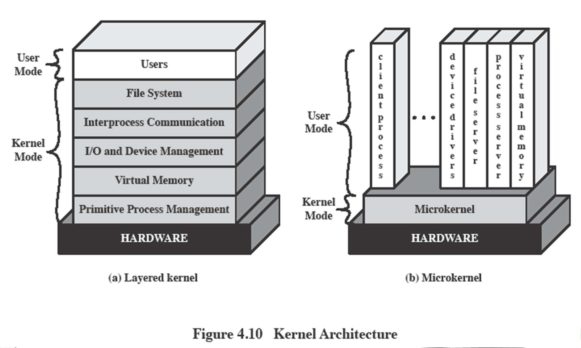
Kernel Architecture

Slide 40

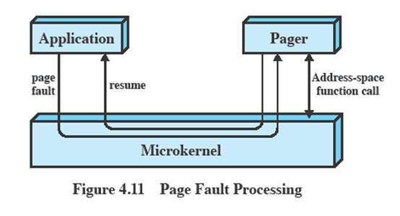
Microkernel Design: Memory Management
Low-level memory management - Mapping each virtual page to a physical page frame
– Most memory management tasks occur in user space

Slide 41
Microkernel Design: Interprocess Communication
Communication between processes or threads in a microkernel OS is via messages.
A message includes:
A header that identifies the sending and receiving process and
A body that contains direct data, a pointer to a block of data, or some control information about the process.

Slide 42
Microkernal Design:
I/O and interrupt management
Within a microkernel it is possible to handle hardware interrupts as messages and to include I/O ports in address spaces.
– a particular user-level process is assigned to the interrupt and the kernel maintains the mapping.

Slide 43
Benefits of a Microkernel Organization
Uniform interfaces on requests made by a process.
Extensibility
Flexibility
Portability
Reliability
Distributed System Support
Object Oriented Operating Systems

Slide 44
Roadmap
Threads: Resource ownership and execution
Symmetric multiprocessing (SMP).
Microkernel
Case Studies of threads and SMP:
Windows
Solaris
Linux

Slide 45
Different Approaches to Processes
Differences between different OS’s support of processes include
How processes are named
Whether threads are provided
How processes are represented
How process resources are protected
What mechanisms are used for inter-process communication and synchronization
How processes are related to each other

Slide 46
Windows Processes
Processes and services provided by the Windows Kernel are relatively simple and general purpose
Implemented as objects
An executable process may contain one or more threads
Both processes and thread objects have built- in synchronization capabilities

Slide 47
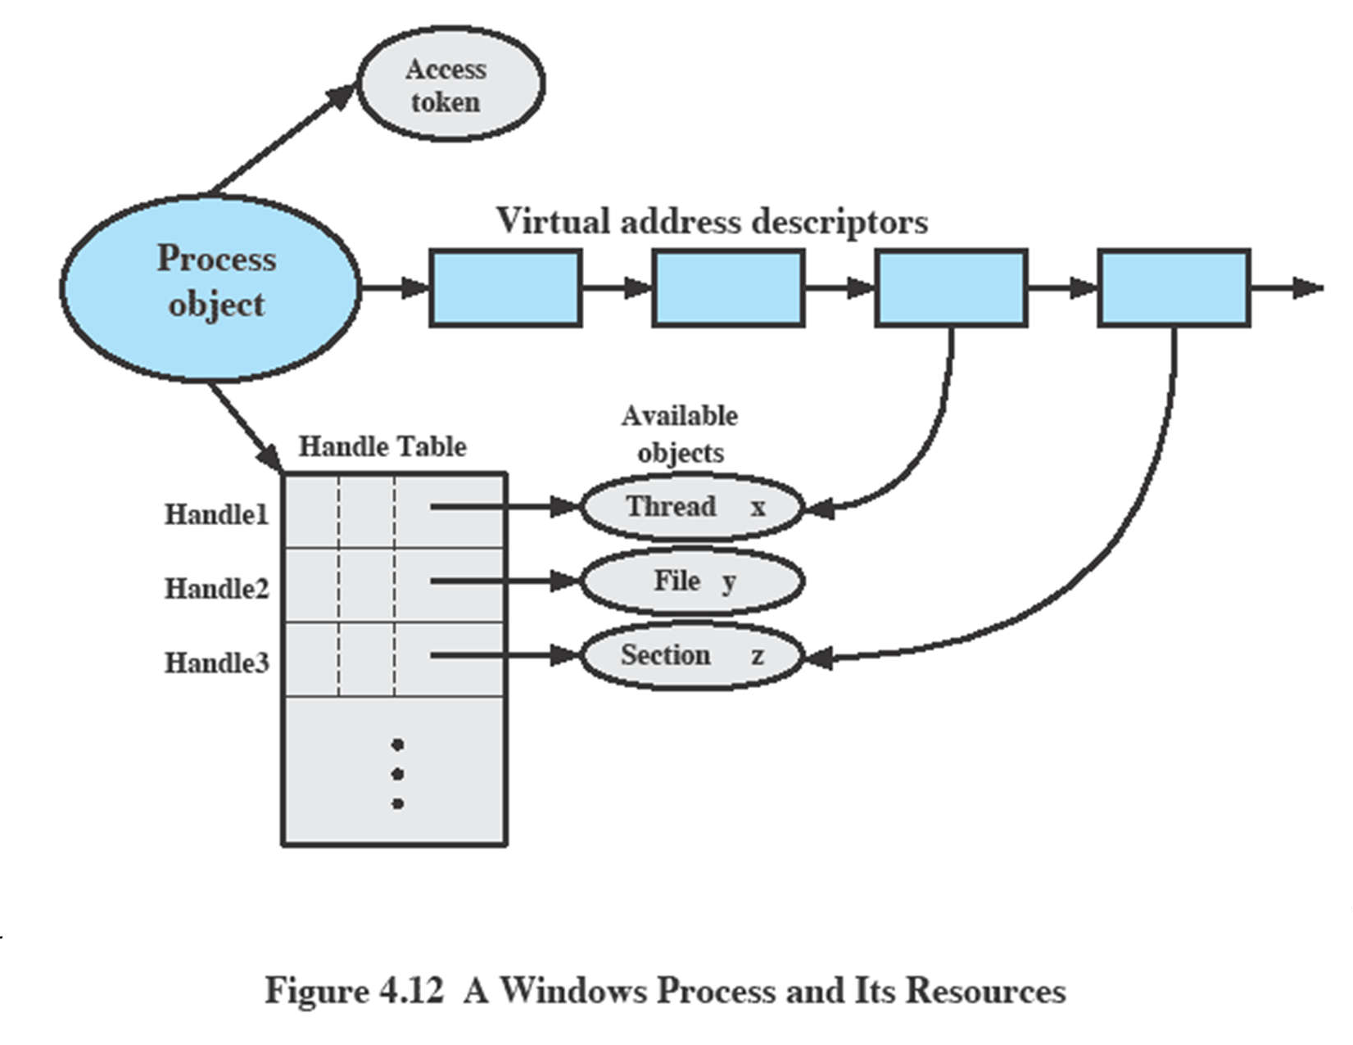
Relationship between Process and Resources

Slide 48
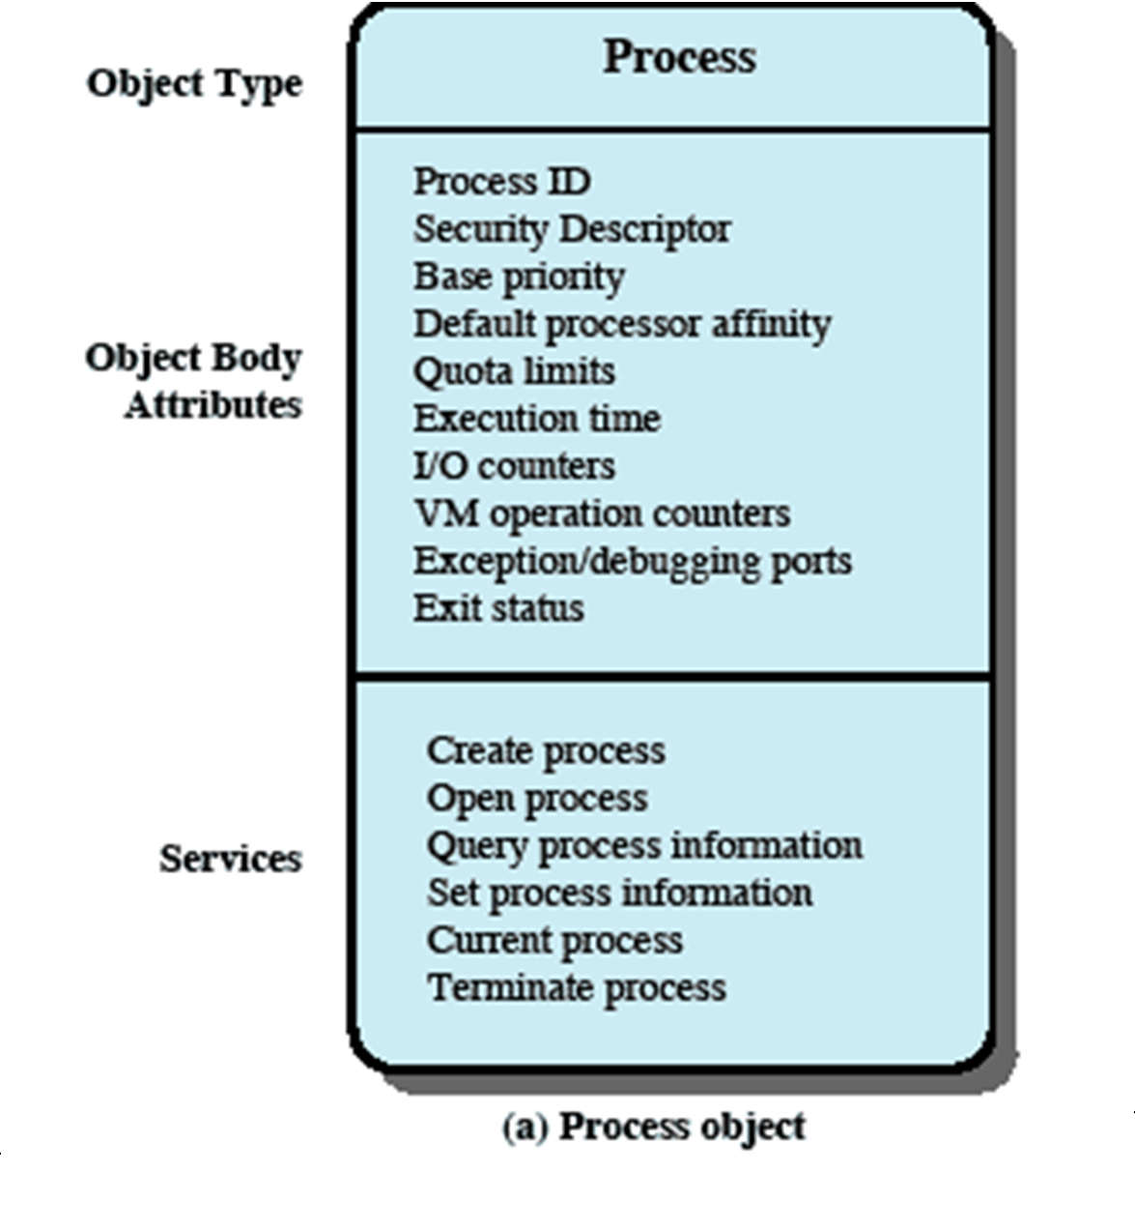
Windows Process Object

Slide 49
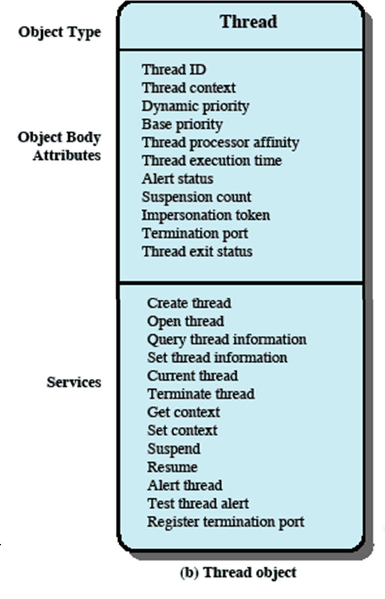
Windows Thread Object

Slide 50
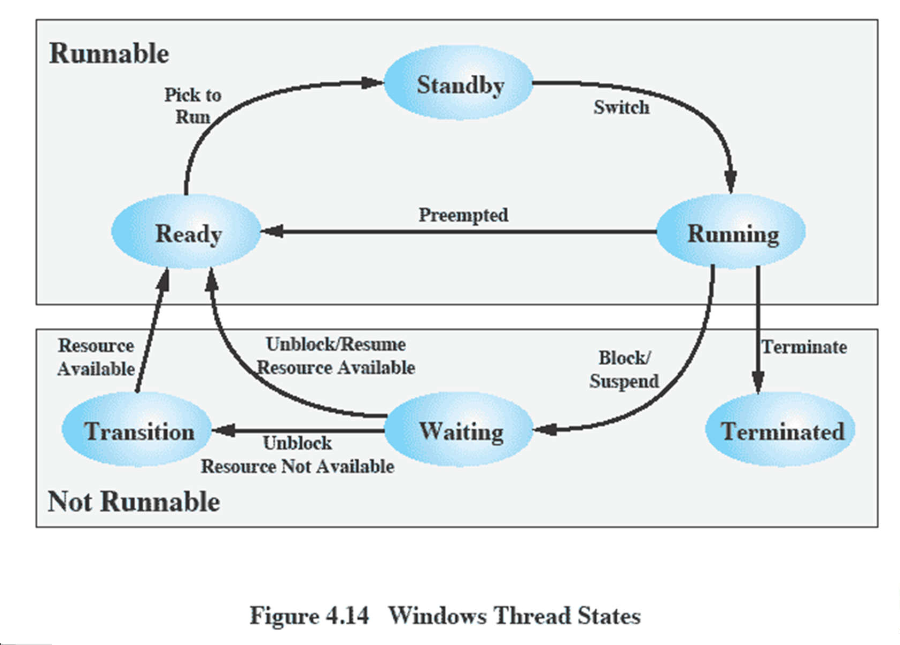
Thread States

Slide 51
Windows SMP Support
Threads can run on any processor
But an application can restrict affinity
Soft Affinity
The dispatcher tries to assign a ready thread to the same processor it last ran on.
This helps reuse data still in that processor’s memory caches from the previous execution of the thread.
Hard Affinity
An application restricts threads to certain processor

Slide 52
Solaris
Solaris implements multilevel thread support designed to provide flexibility in exploiting processor resources.
Processes include the user’s address space, stack, and process control block

Slide 53
Solaris Process
Solaris makes use of four separate thread- related concepts:
Process: includes the user’s address space, stack, and process control block.
User-level threads: a user-created unit of execution within a process.
Lightweight processes: a mapping between ULTs and kernel threads.
Kernel threads

Slide 54
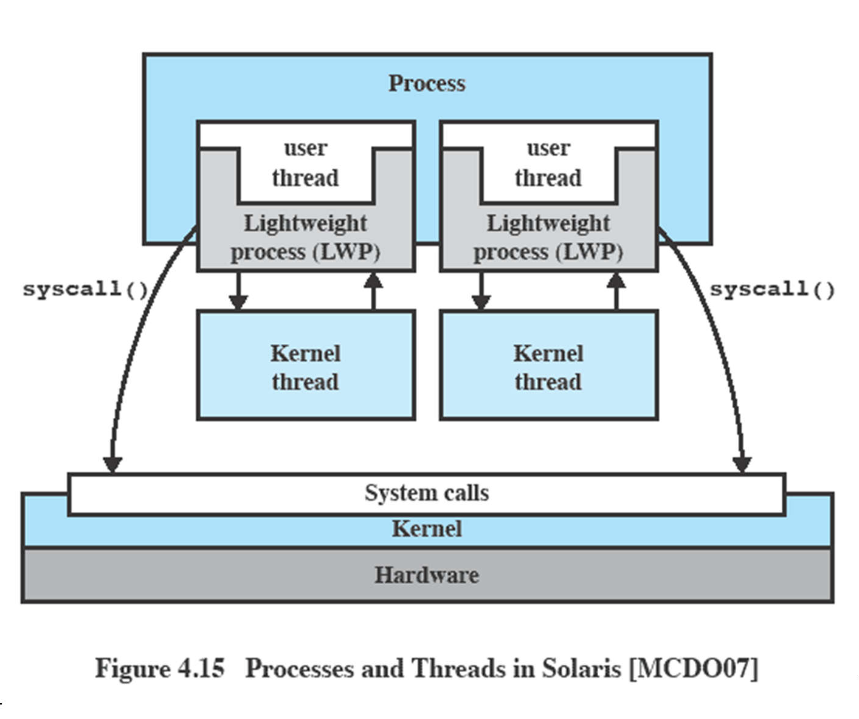
Relationship between Processes and Threads

Slide 55
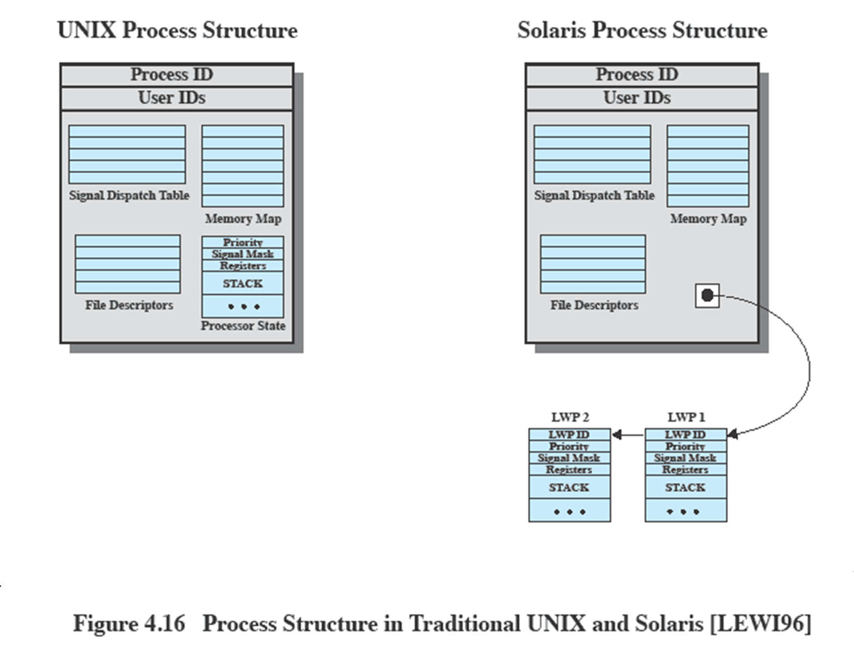
Traditional Unix vs Solaris
Solaris replaces the processor state block with a list of LWPs

Slide 56
LWP Data Structure
An LWP identifier
The priority of this LWP
A signal mask
Saved values of user-level registers
The kernel stack for this LWP
Resource usage and profiling data
Pointer to the corresponding kernel thread
Pointer to the process structure

Slide 57
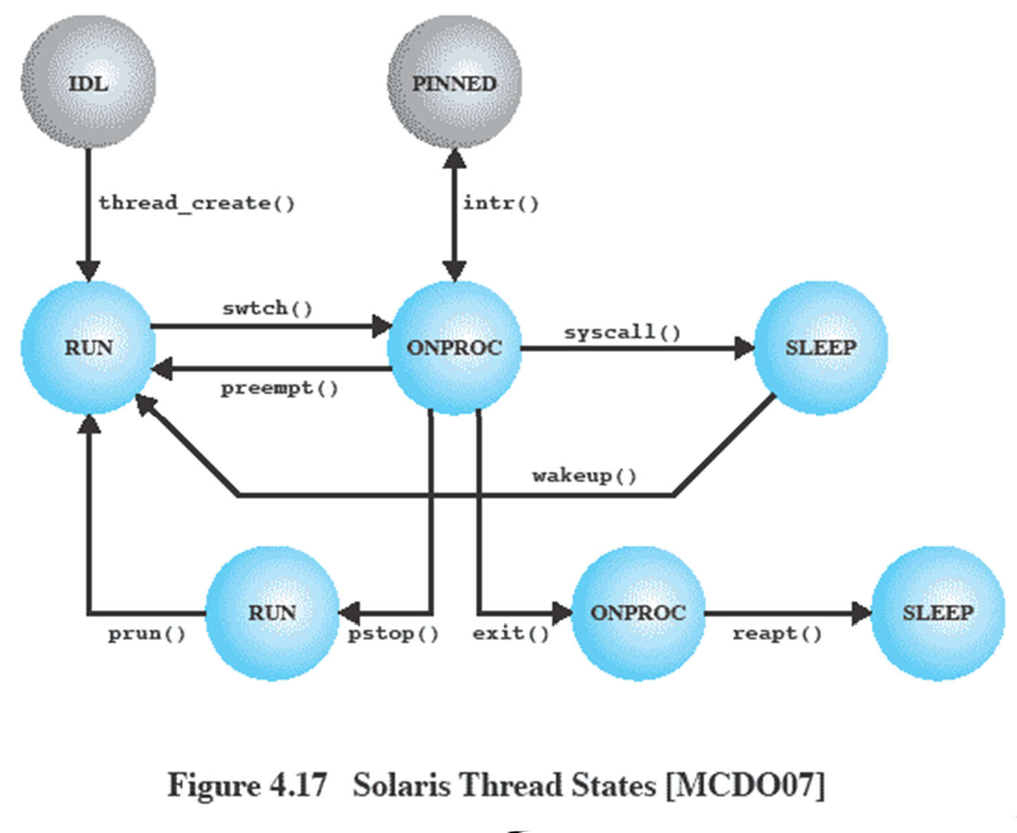
Solaris Thread States

Slide 58
Linux Tasks
A process, or task, in Linux is represented by a task_struct data structure
This contains a number of categories including:
State
Scheduling information
Identifiers
Interprocess communication
And others

Slide 59
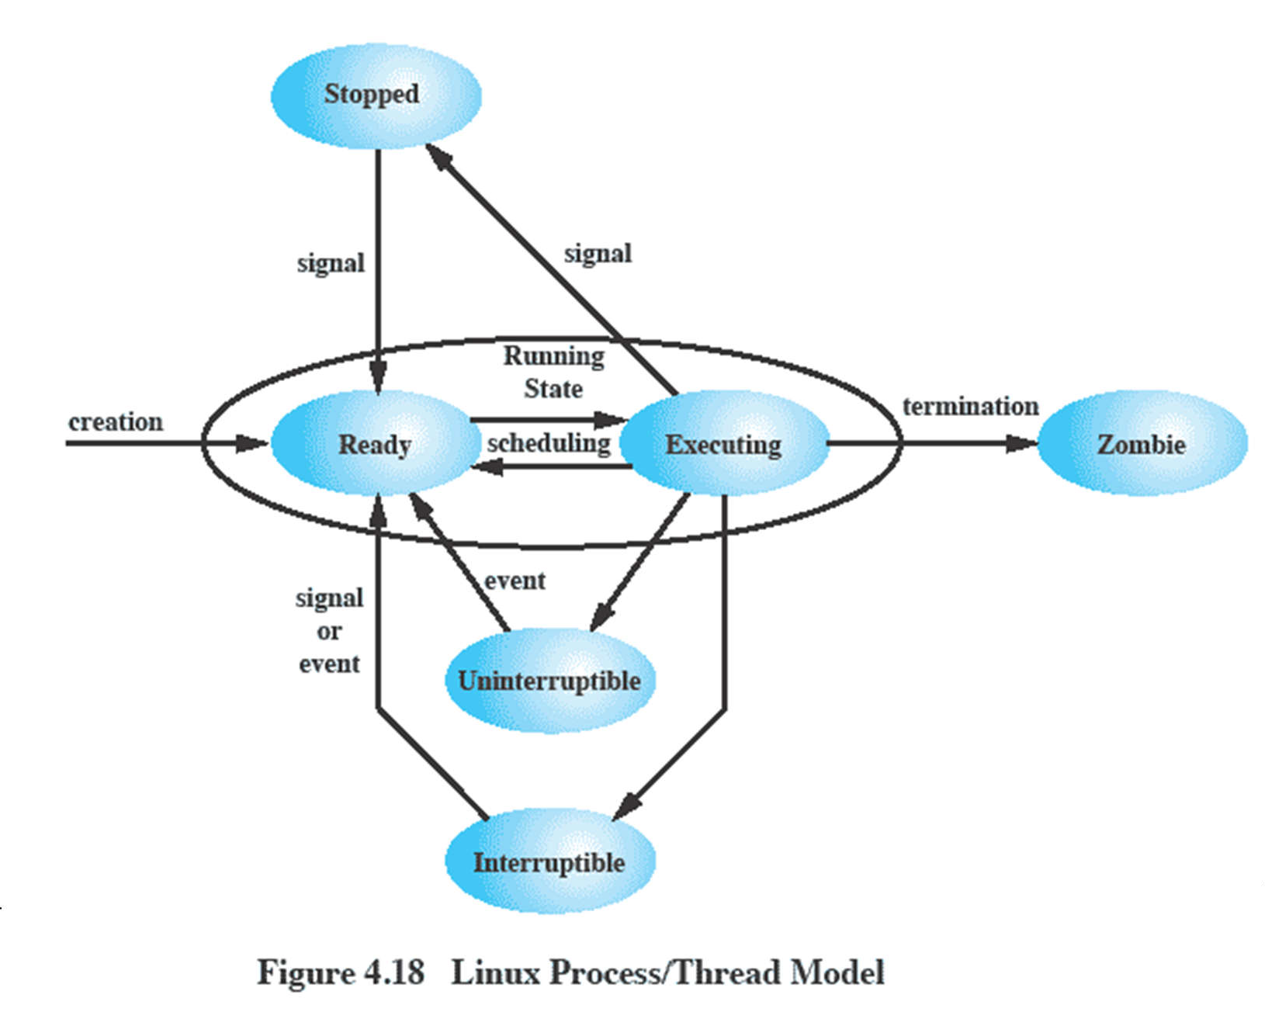
Linux Process/Thread Model

